Slide 1
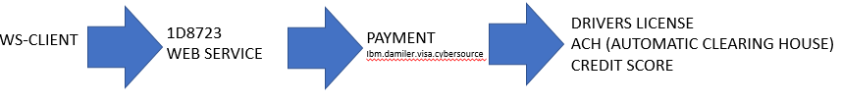
FBI
WHITE COLOR CRIME - TECHNOLOGY
ibm saml webspere webservices soap
Authenticate web service clients with a SAML (Security Markup Assertion Language) Token
WS-Security policy
a SAML token to the web services provider as a means of identifying the requester
1D8723
WEB SERVICE
DRIVERS LICENSE
ACH (AUTOMATIC CLEARING HOUSE)
CREDIT SCORE
WS-CLIENT
PAYMENT
Ibm.damiler.visa.cybersource
com.ibm.websphere.security.saml2.Saml20Token

Slide 2
FBI
WHITE COLOR CRIME - TECHNOLOGY
server.xml <featureManager>
<feature>wsSecuritySaml-1.1</feature>
</featuremanager>
.wsdl SAML token
<wsp:Policy wsu:Id="CallerHttpPolicy">
<sp:SupportingTokens>
<wsp:Policy>
<sp:SamlToken sp:IncludeToken="http://ibm.io/ws/ws-securitypolicyIncludeToken/AlwaysToRecipient">
<wsp:Policy>
<sp:WssSamlV20Token11 />
</wsp:Policy>
</sp:SamlToken>
</wsp:Policy>
</sp:SupportingTokens>
</wsp:Policy>

Slide 3
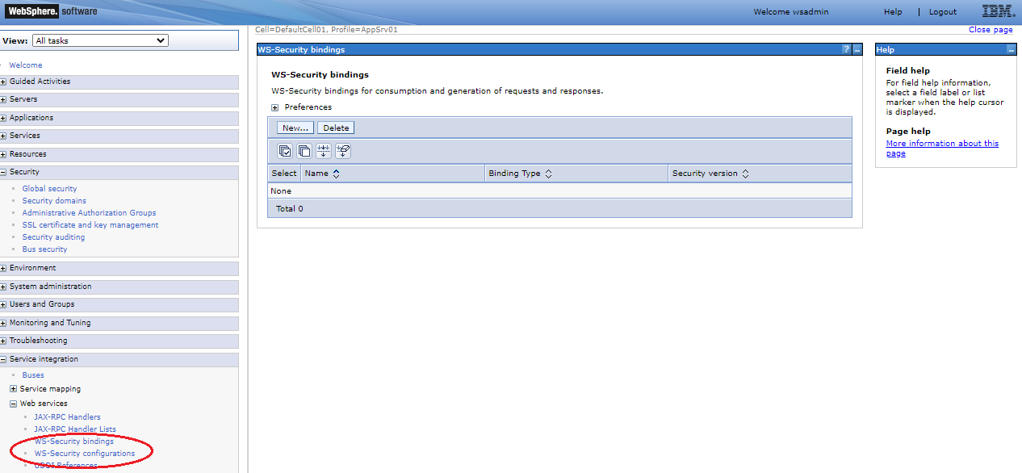
FBI
WHITE COLOR CRIME - TECHNOLOGY
server.xml <featureManager>
<feature>wsSecuritySaml-1.1</feature>
</featuremanager>
.wsdl SAML token
<wsp:Policy wsu:Id="CallerHttpPolicy">
<sp:SupportingTokens>
<wsp:Policy>
<sp:SamlToken sp:IncludeToken="http://ibm.io/ws/ws-securitypolicyIncludeToken/AlwaysToRecipient">
<wsp:Policy>
<sp:WssSamlV20Token11 />
</wsp:Policy>
</sp:SamlToken>
</wsp:Policy>
</sp:SupportingTokens>
</wsp:Policy>

Slide 4
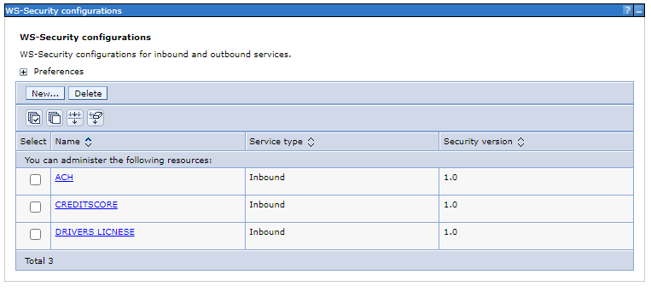
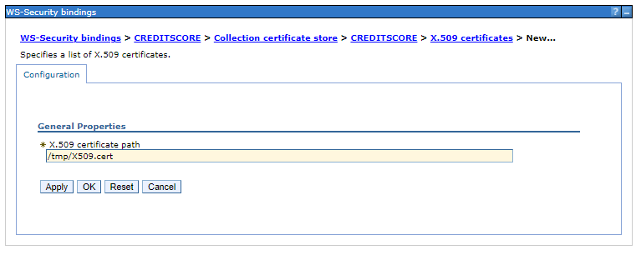
FBI
WHITE COLOR CRIME - TECHNOLOGY

Slide 5
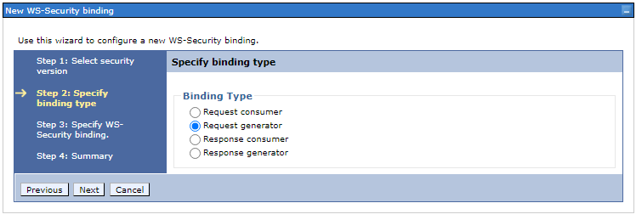
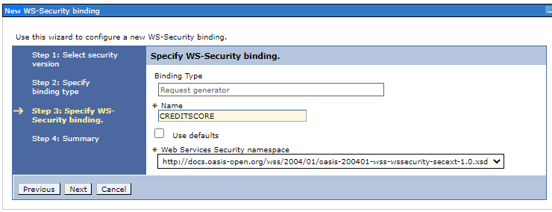
FBI
WHITE COLOR CRIME - TECHNOLOGY

Slide 6
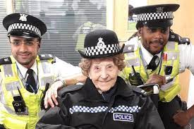
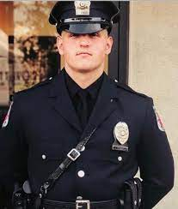
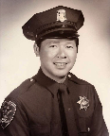

FBI
WHITE COLOR CRIME - TECHNOLOGY
nana
<nonPoliceOperation>
<nonPoliceSAML>
papa
Robert
Mike
wsdl:binding or wsdl:operation
https://www.ibm.com/docs/en/was-liberty/base?topic=security-web-services-message-level
nonPoliceTRX
Commuity Banks
<nonPoliceSAML>
Authenticate the Web Service with a SAML token
<nonPoliceOperation>
.wsdl file.

Slide 7
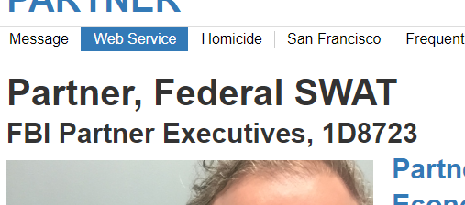

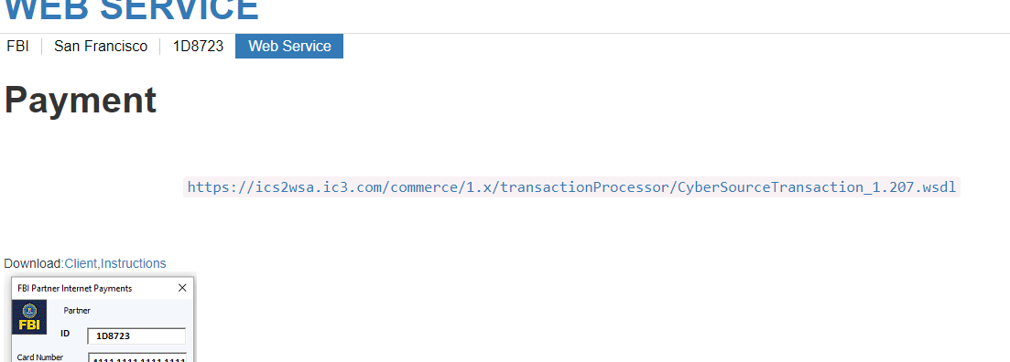
FBI
WHITE COLOR CRIME - TECHNOLOGY
PAYMENT

